Slide 1


Food Grabber
Pixelated Dreams Studio

Slide 2

About Our Game
Inspired by a fruit cutting game…
Definitely Not “A COPY”
Grab Fruits Foods!!!
Eat (Maybe)
Burn Calories ;)

Slide 3

The power of Hands Using the interactive input system to catch food.

Slide 4
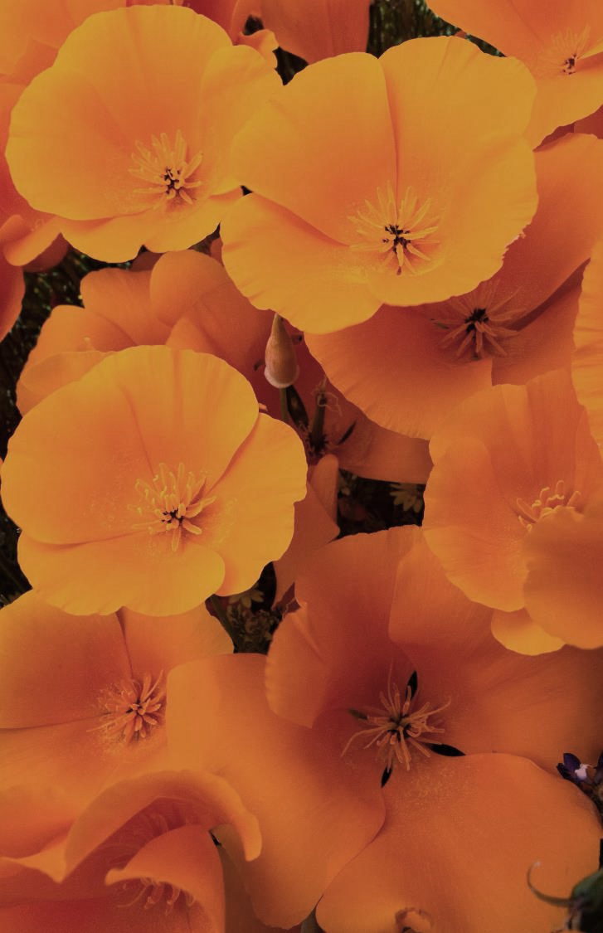
Overcoming Bad Eating Habits
Grabbing something healthy unlike you
~ GPT-4o mini

Slide 5
Engaging the audience
Interactive
VR
Makes you crave healthy foods
Earn food points
Don’t leave those fruit falling
“Unity’s Particle System”

Slide 6
Thank you
Anjana Modugu
Ayush Kumar

